Slide 1
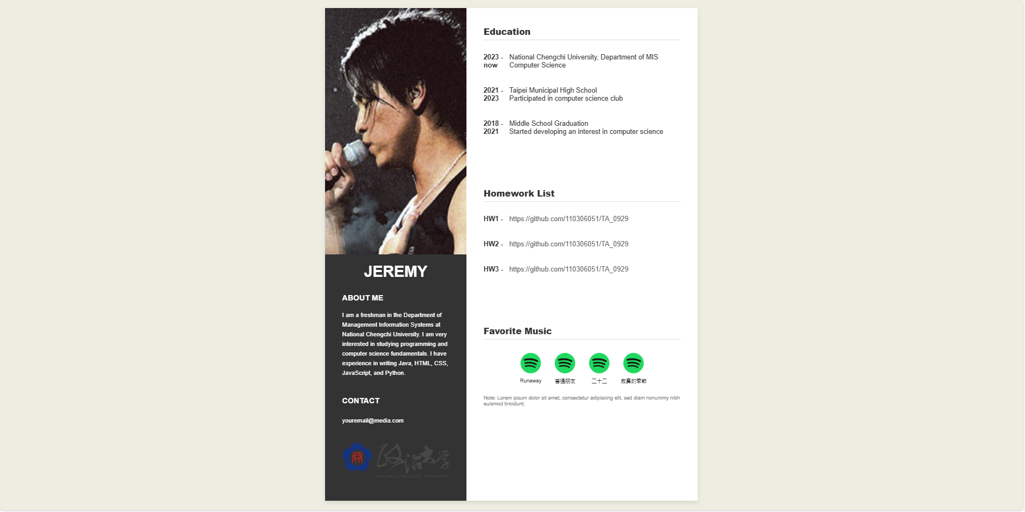
Today’s Homework

Slide 2
display 屬性
display 控制元素在頁面上的顯示方式，它決定了元素是以 塊級元素（Block Element）、行內元素（Inline Element）佈局模式呈現。
不同的 display 值可以改變元素的佈局行為、參與排版的方式，進而影響它與其他元素的關係。
display 的常見值包括：
block
inline
inline-block
none
flex
grid

Slide 3
block（塊級元素）
當一個元素的 display 設置為 block 時，它會作為塊級元素呈現，這意味著該元素會獨占一行，並且自動擴展到與其父容器同寬。塊級元素可以包含寬度、高度、內距和外距等屬性。
常見預設為 block 的 HTML 標籤：
<div>
<p>
<h1> – <h6>
<section>
<article>
<header>
<footer>

Slide 4
inline（行內元素）
inline 顯示的元素稱為行內元素，這種元素不會佔據整行，它只佔據其內容所需的寬度，並且可以與其他行內元素排在同一行。
行內元素不能設置寬度和高度，也無法影響垂直方向的 margin 和 padding。
常見預設為 inline 的 HTML 標籤：
<span>
<a>
<em>（斜體）
<strong>（加粗）
<img>（圖片也屬於行內元素）

Slide 5
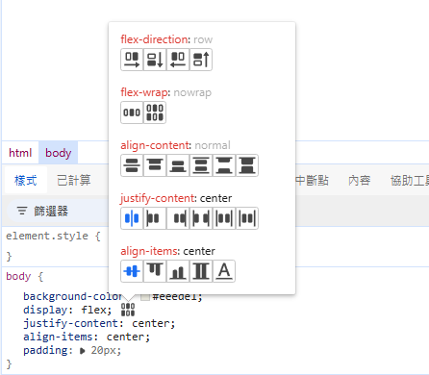
flex（彈性佈局）
flex 是一種強大的佈局模式，允許我們創建靈活的響應式布局。
當一個容器的 display 設置為 flex，它的子元素會根據 flex 規則進行排列和調整。
flex 支持橫向或縱向排列、換行、自動伸縮等功能。
常見的 flex 屬性包括：
justify-content：控制主軸上的對齊方式。
align-items：控制交叉軸上的對齊方式。
flex-wrap：控制子元素是否換行。

Slide 6
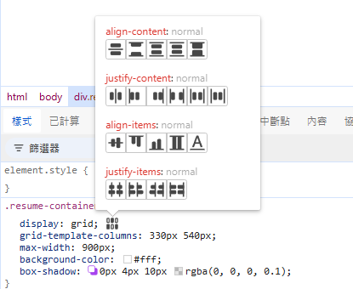
grid（網格佈局）
grid 是另一個強大的佈局模式，用來創建基於網格的兩維佈局。
當一個容器設置為 grid 佈局，它的子元素會根據行和列來排列，可以精確控制元素的大小、間距和位置。
常見的 grid 屬性包括：
grid-template-columns：設置列數和列寬。
grid-template-rows：設置行數和行高。
grid-gap：控制行與列之間的間距。

Slide 7
Requirement #1
Container Design:
The body should set the layout that centers your content.
The layout should be placed within a container (.main-container) that centers the content and does not overflow beyond a specified width. (example is 900px )
The container should be a flex layout or grid layout (recommend), with a proper width to maintain proper alignment and spacing.
The background of the container should be a color you want, with a soft shadow effect to give it a clean and modern look.
example : body {
background-color: #eeede1;
display: flex;
justify-content: center;
align-items: center;
padding: 20px;
}

Slide 8
Requirement #2
Panel Division:
The layout must be divided into two panels:
  Left Panel: Contains personal information, profile picture, and contact info.
  Right Panel: Displays sections like education, homework list, and favorite music.
The panels should have defined widths:
  Left panel: 330px width (or you can define as you want)
  Right panel: 540px width (or you can define as you want)
Both panels should be vertically aligned, ensuring that the content fits within the container's height without breaking the layout. (for the example the height of the panel is set as 1150px)

Slide 9
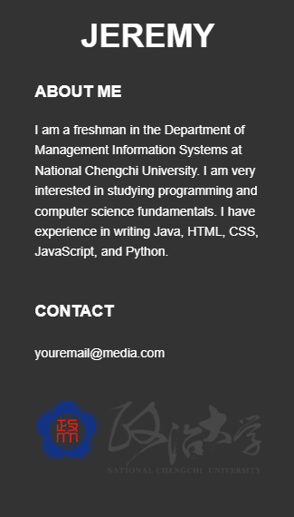
Requirement #3
Left Panel Structure:
The left panel (.left-panel) should be divided into two main div elements:
  Photo Panel (.photo-panel): This will display the background image.
  Text Content Panel (.text-content): This will contain the "About Me" section, contact info, and the NCCU icon at the bottom.
Photo Panel (.photo-panel):
Set the background-image for the .photo-panel to fill the entire div and adjust the background position (background-position) to ensure the image is placed appropriately (e.g., centered or top-aligned).
The height of the .photo-panel should cover 50% of the left panel's height.
Ensure that the text content does not overlap the image by creating enough space for the text below it.
Text Content Panel (.text-content):
Inside the .text-content div, include two sections:
  "About Me" Section: A paragraph or short bio about the individual.
  Contact Info Section: Display contact information like email, phone number, or social media links.
At the bottom of the .text-content panel, include the NCCU Icon, ideally in the form of an img tag or an SVG, aligned to the bottom of the section.

Slide 10

Requirement #4
Section Structure:
The right panel should be divided into three distinct sections:
  Education
  Homework List
  Favorite Music
General Section Styling:
Each section should have a title (h2), with a bottom border separating the title from the content below it. This will provide a clear visual distinction between the sections.
Education Section:
The Education section should have a timeline that properly aligns the year and description for each entry.
  The year (.year) and description should be placed side by side with adequate spacing between each item.
  Ensure that the years and descriptions are clearly readable, and that there is sufficient margin or padding between timeline items for a clean layout.

Slide 11
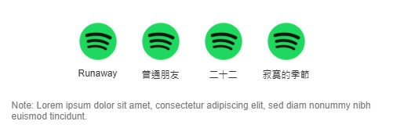
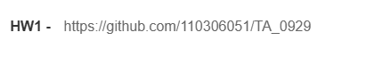
Homework List Section:
In the Homework List section, there should be clickable links to external homework URLs (GitHub links).
Links should not have an underline by default. Instead, you can apply other design techniques (such as changing the text color or adding hover effects) to indicate that the links are clickable.
Favorite Music Section:
The Favorite Music section should display four images (album covers, for example) in a single row, evenly spaced and properly aligned.
Ensure that the images are centered in the row, and that the layout works responsively on different screen sizes.
Each image should be a clickable link that opens the corresponding song or music video when clicked. This can be achieved by wrapping each image in an <a> tag with the appropriate URL.
Ensure the images are of a uniform size and aspect ratio for a balanced look.
Note Section:
Below the Favorite Music section, add a note providing thoughts or recommendations related to the four songs.
  The note can be a short description of the songs or why they were chosen.
  Ensure that the note has a small font size and subtle styling, so it doesn’t overpower the content above it but still provides useful information for the reader.

Slide 12
Due by Nov. 21 (Thur), 11:59pm
Name your repository "StudentID_HW5"
Put ALL material and code in your repository
Submit the url of your repository to Moodle

